Slide 1
Yelp Dataset Challenge: Business Analysis Based on Location and Category
GROUP - I :
KEYUR MANDANI OVANES MIKAELIAN HEMANTH REDDY

Slide 2
Table of contents
Introduction
Cluster Configuration
Agenda
Flowchart
Specifications
Implementation
Visualization
GitHub
References

Slide 3
What is Yelp? --Yelp is a user driven web 2.0 service which reveals honest and current insights on local businesses
--Yelp allows users from anywhere in the world to rate and review any business.
--Yelp's revenues come from selling ads and sponsored listings to small businesses.
--Harvard Business School study published in 2011 found that each star in a Yelp rating affected the business owner's sales by 5-9 percent.

Slide 4
What is Yelp? --Yelp is a user driven web 2.0 service which reveals honest and current insights on local businesses
--Yelp allows users from anywhere in the world to rate and review any business.
--Yelp's revenues come from selling ads and sponsored listings to small businesses.
--Harvard Business School study published in 2011 found that each star in a Yelp rating affected the business owner's sales by 5-9 percent.

Slide 5
Microsoft Azure HDInsight Cluster
Configuration
Operating System : Linux
Nodes: 4 Node
Worker Nodes: 4 Nodes -16Core –14Gb RAM – 200Gb SSD
Head Nodes: 2 Nodes - 8Core –14Gb RAM – 200Gb SSD

Slide 6
Tools Used
Microsoft Azure HDInsight Cluster Hadoop Environment
PowerBI for Data Visualization
Amazon AWS S3 : Store data Online and To Fetch to HDFS
Jsonprettyprinter : Format non-structured Data into structured data
Mapping tools at Batchgeo.com

Slide 7
Agenda
Analyze Yelp Academic Dataset from various business perspectives, including business location, category, time of year, user rating and user reviews.

Slide 8
Dataset Details
Data source: Yelp Academic Dataset
Data size : 1.98 GB
File Format : json
Number of files : 3

Slide 9
PROCESS FLOW
Downloaded data from Yelp website
Converted Json file to .CSV file using Serialization/Deserializtion (SerDe)
Export Data to Excel
1
2
3
4
5
6
Upload Files to HDInsight Cluster using SSH
Used HiveQL to Retrieve data and create tables
Dashboard Data visualization

Slide 10
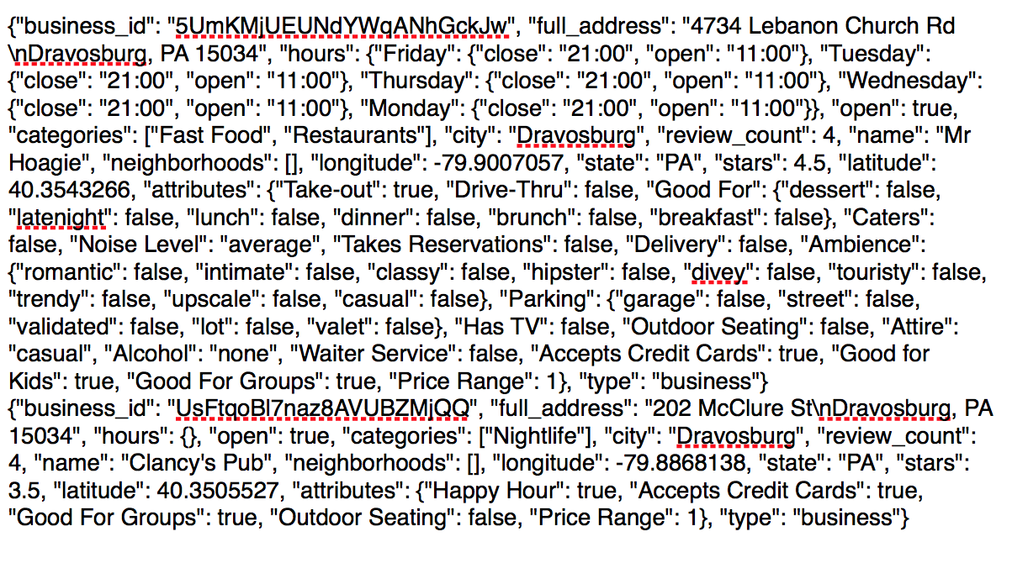
Raw JSON Data

Slide 11
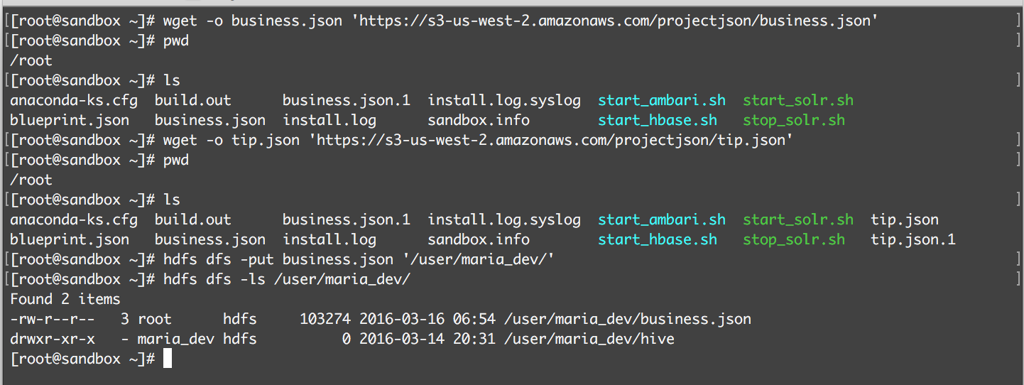
Upload JSON Files to HDInsight Cluster Using SSH
Download File: Wget –O Filename ‘ URL’‘FileDestination’
Move File to HDFS: hdfs dfs –put filename ‘File Destination Path’

Slide 12
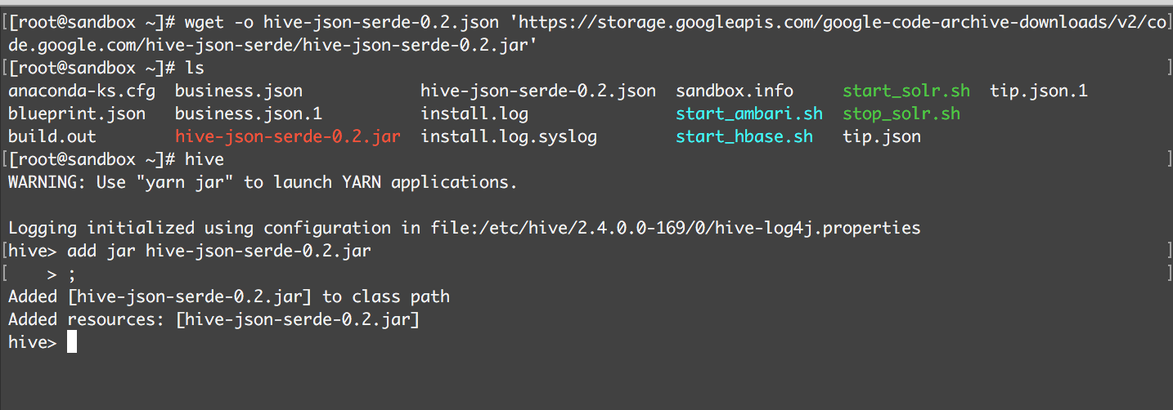
Downloading Json-Serder File for Hive

Slide 13
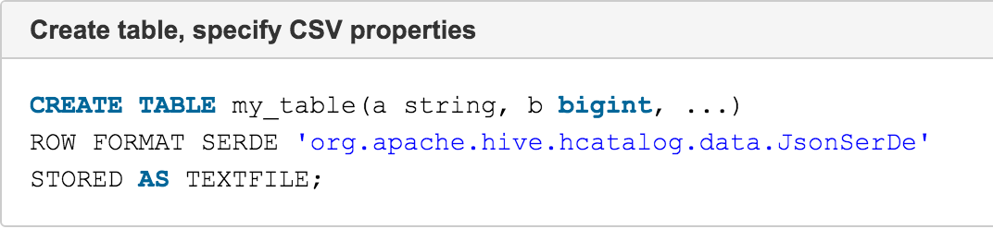
Create Table with Serde (JsonSerde)
NOTE:-While Creating table using Hive-JsonSerde,
class path for Serde Needs to be specified
with the table.

Slide 14
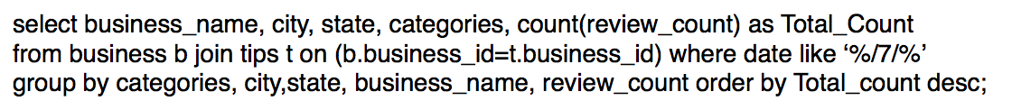
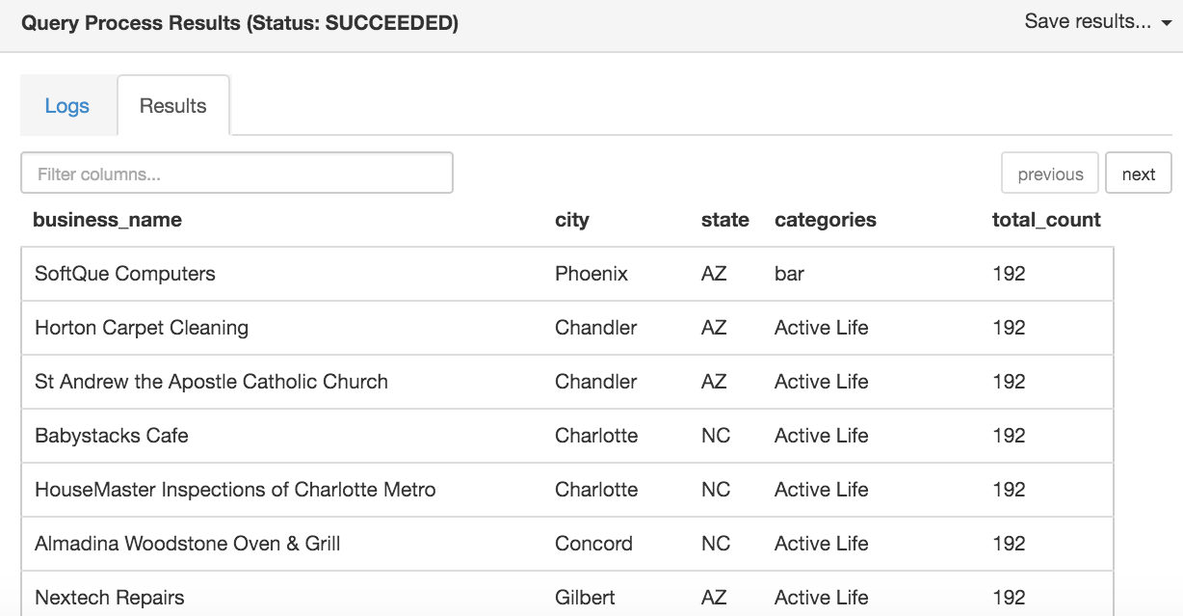
Query To Display Review Count on Specific Time of Year

Slide 15
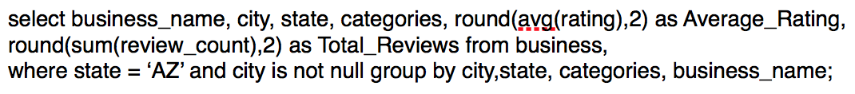
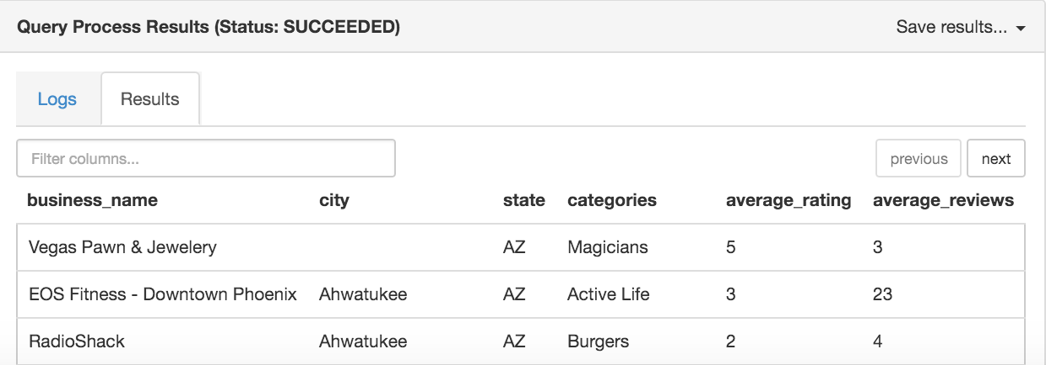
Average Rating and Average Review

Slide 16
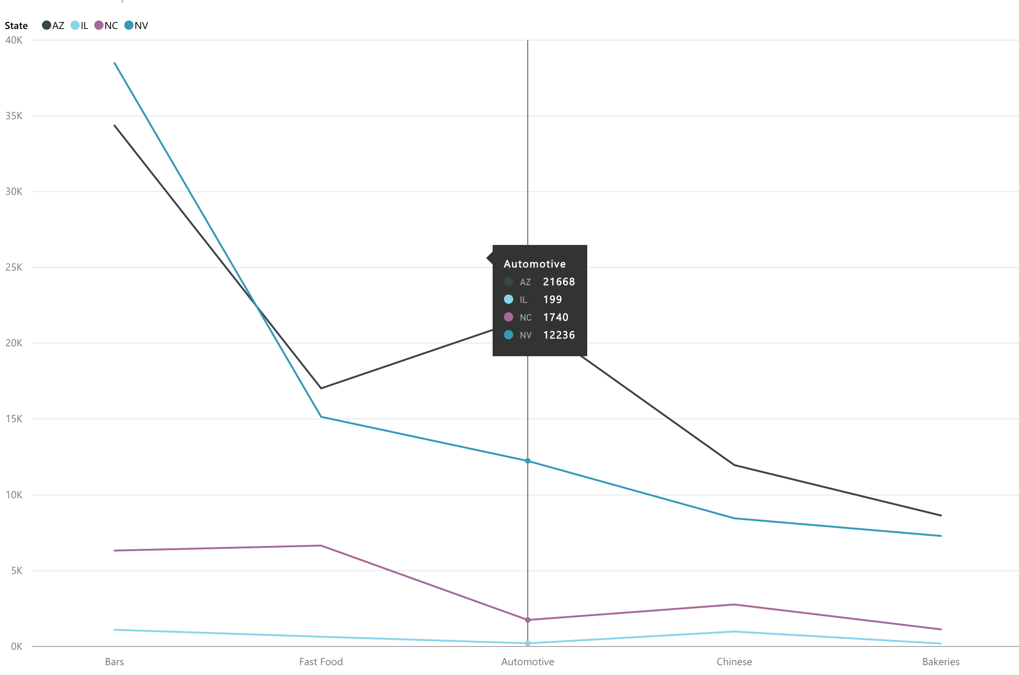
Total Reviews by Business Category in Selected States

Slide 17
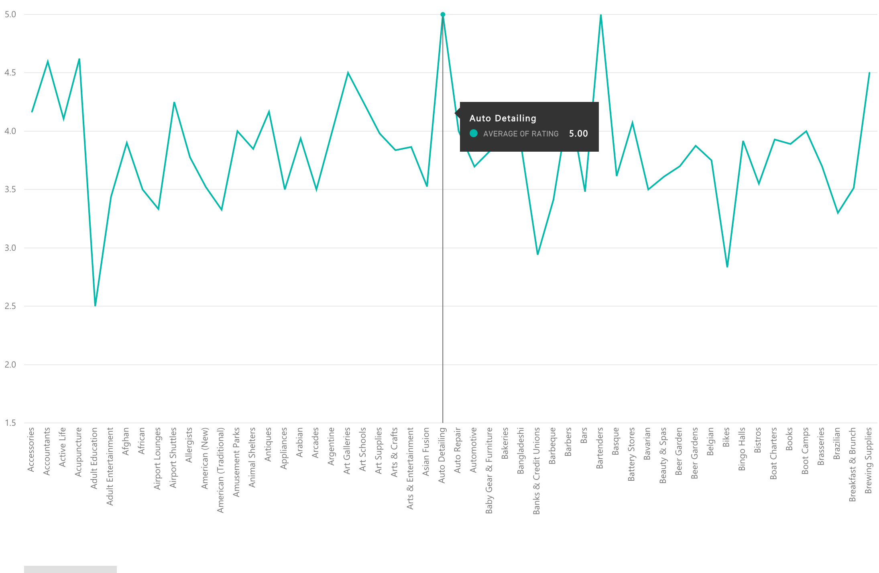
Average Rating by Business Category in US

Slide 18
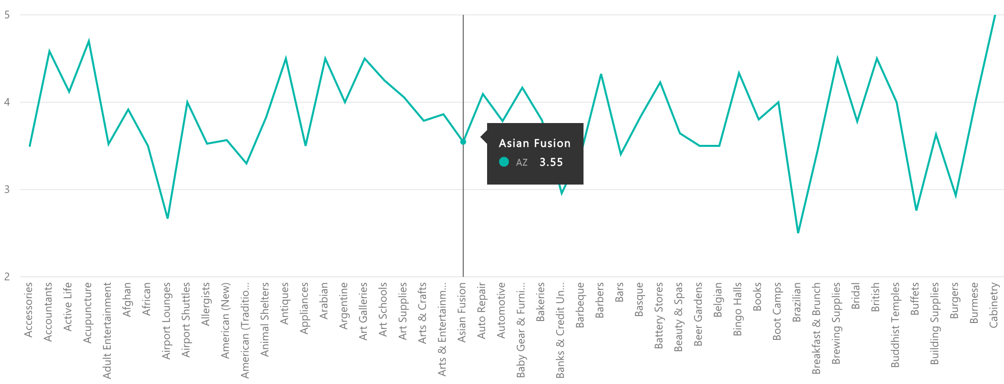
Average Rating For Business In Arizona State

Slide 19
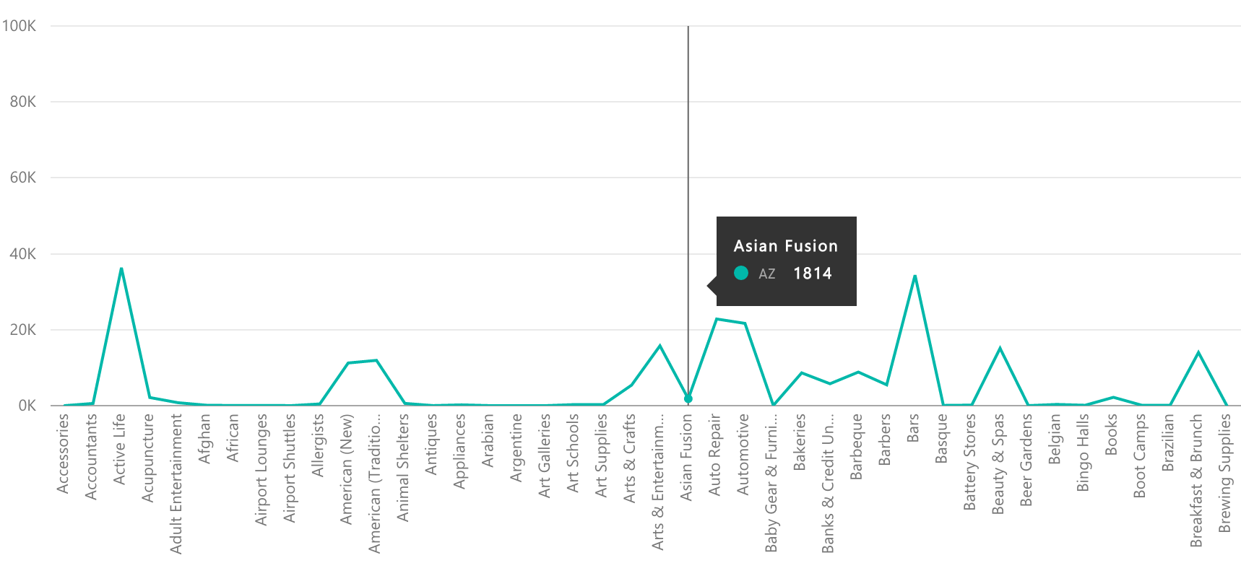
Total Number of Reviews for Business in Arizona State

Slide 20
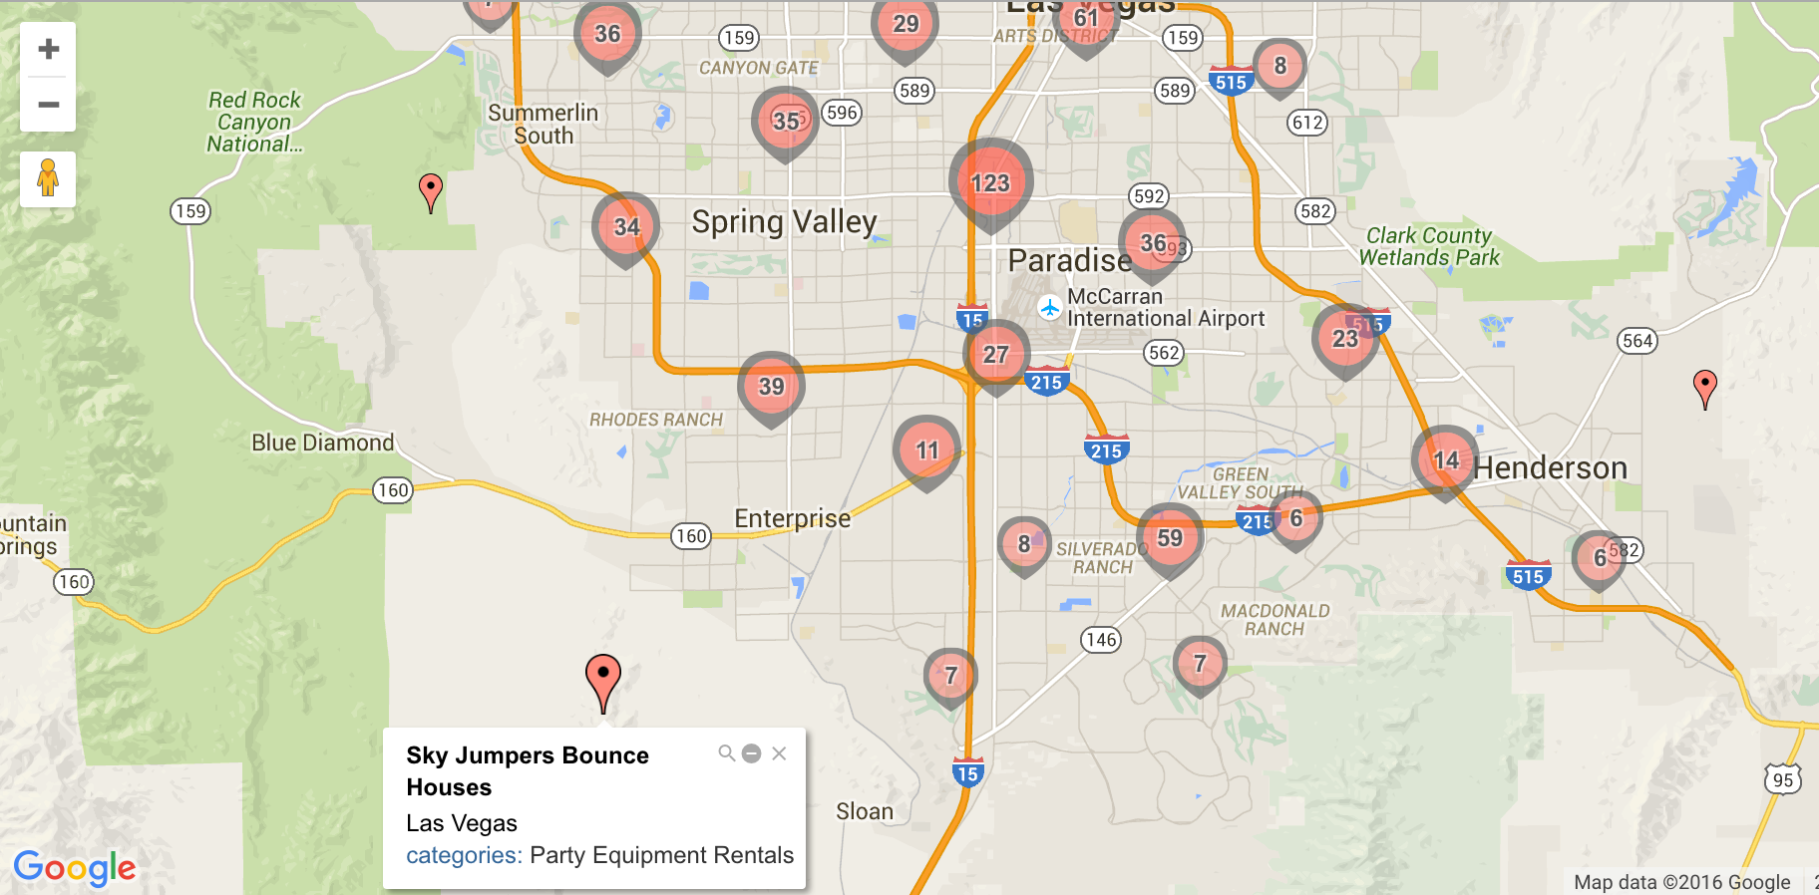
Businesses in Las Vegas based on Longitude and Latitude
using batchgeo.com

Slide 21
Project Scope
Natural Language Processing:
From the review provided from the users, based on the positive and negative words, we can predict the rating a particular user will give.
Bluemix’s Natural Language Classifier can be used

Slide 22
References
GitHub Repository: https://github.com/Keyur-Mandani/CIS520-01-G-I.git
SlideShare: http://www.slideshare.net/MandaniKeyur/yelp-academic-dataset
Dataset : https://www.yelp.com/dataset_challenge/dataset
Serde Source: http://code.google.com/p/archive/hive-json-serde-0.2.jar
References from Class Lab Work
Azure HDInsight Hadoop Linux Cluster Getting Started Artical
www.tutorialpoints.com/hive

